Slide 1
SWE2210 Software Construction
Lecture 01
Venue: Lab 3
Time: 11 – 1:00pm

Slide 2
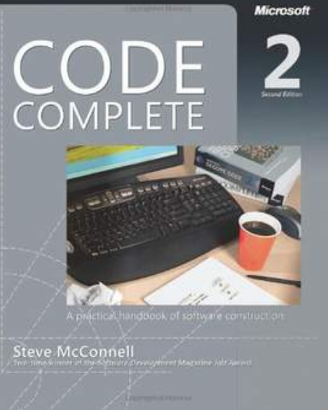
The Course
SWE2210: Software Construction
2 Credit hours
Recommended Text Book:
Code Complete: A Practical Handbook of Software Construction
By Steve McConnell
Microsoft Press
952 pages

Slide 3
Course Tutors
Bashir Shehu Galadanci (Ph.D.)
Buhari Ubale

Slide 4
Course Assessment
C.A. - 30%
Exam - 70%

Slide 5
Outline of Today’s Lecture
Introduction.
What is software construction.
Construction and non-construction activities
Why is software construction importance?
Metaphors for software construction.
Software construction approaches.

Slide 6
Introduction
Outside the software development discipline “Construction” is the work “construction workers” do when build an object like house, school.
In software development concept “Construction” is sometimes known as “coding” or “programming.” “Coding” isn’t really the best word because it implies the mechanical translation of a preexisting design into a computer language

Slide 7
Introduction cont..
Software Construction is the central activity in software development which lies between design and test.
“design -> construct -> test”

Slide 8
What is Software Construction?
Software construction is a fundamental act of software engineering which refers to creation of working and meaningful software through a combination of detailed design, coding, debugging, construction planning, unit testing and integration testing.

Slide 9
What is Software Construction?
Looking at complexity of software product Numerous activities have been identified by that go into software development.
Problem definition
Requirements development
Construction planning
Software architecture, or high-level design
Detailed design
Coding and debugging
Unit testing
Integration testing
System testing
Corrective maintenance

Slide 10
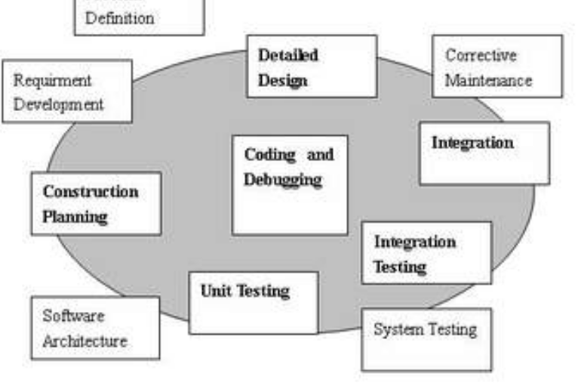
Construction and Non-Construction Activities

Slide 11
Non-Construction Activities
Requirements Analysis and Design are done before construction so that you can do construction effectively.
System testing is done after construction to verify that construction has been done correctly.
Other non-construction activities include software architecture and maintenance.

Slide 12
Construction Activities
Here are some of the specific tasks involved in construction:
Verifying that the groundwork has been laid so that construction can proceed successfully
Determining how your code will be tested.
Designing and writing classes and routines
Creating and naming variables and named constants
Selecting control structures and organizing blocks of statements
Unit testing, integration testing, and debugging your own code
Polishing code by carefully formatting and commenting it
Integrating software components that were created separately
Tuning code to make it faster and use fewer resources

Slide 13
Why is Software Construction Important
The reasons why construction is importance are as follows:
Software construction is the largest part of software development
Construction is the central activity in software development
Construction is the only activity that’s guaranteed to be done.
Software construction it improve individual programmer’s productivity.

Slide 14
Metaphors for Software Construction
Writing Code: Traditionally programs (sometimes called code) are written, compiled, tested and run.
Software Farming: Software Development is like planting seeds and growing crops
Building Software: The activities you do before, during and after building projects are the same activities done when developing software

Slide 15
Measure Twice, Cut Once
The carpenter’s saying, “Measure twice, cut once” is highly relevant to software construction.
A common denominator of programmers who build high-quality software is their use of high-quality practices.
Such practices emphasize quality at the beginning, middle, and end of a project.
Notes:
Double check your measurement for accuracy before cutting a pierce of wood; otherwise it may be necessary to cut again, wasting time, resources and money.

Slide 16
Quality at the Beginning, Middle and End of a Project
If you emphasize quality at the end of a project, you emphasize system testing but remember that testing can’t detect a flaw or defects such as building the wrong product or building the right product in the wrong way. Such flaws must be worked out earlier than in testing—before construction begins.
If you emphasize quality in the middle of the project, you emphasize construction practices. Such practices are the focus of our course.
If you emphasize quality at the beginning of the project, you emphasize in planning to design a high-quality product.

Slide 17
Two General Approaches
There are 2 general approaches used in Software Construction:
Sequential Approach: The phases of the Software Development Model are strictly implemented sequentially.
Iterative Approach: The phases of the Software Development Model are implemented iteratively

Slide 18
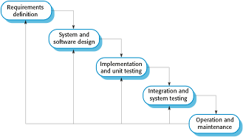
Software Development Models: The Waterfall Model
The model has five (5) phases as shown below:

Slide 19
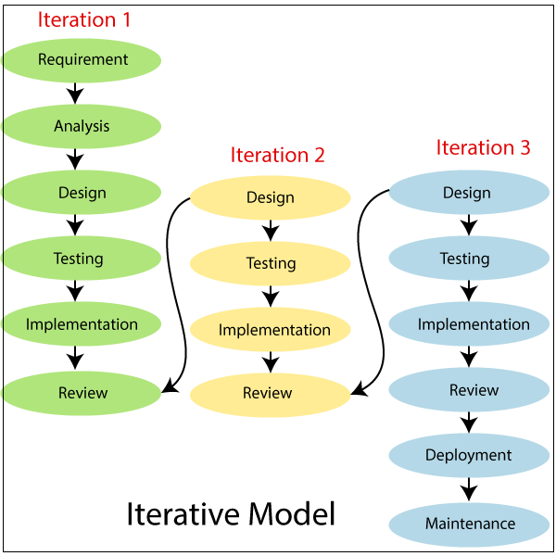
Software Development Models: The Iterative Model

Slide 20
When to Use the Sequential Approach
You might choose a more sequential approach when
The requirements are fairly stable.
The design is straightforward and fairly well understood.
The development team is familiar with the applications area.
The project contains little risk.
Long-term predictability is important.
The cost of changing requirements, design, and code downstream is likely to be high.

Slide 21
When to Use the Iterative Approach
You might choose a more iterative (as-you-go) approach when
The requirements are not well understood or you expect them to be unstable for other reasons.
The design is complex, challenging, or both.
The development team is unfamiliar with the applications area.
The project contains a lot of risk.
Long-term predictability is not important.
The cost of changing requirements, design, and code downstream is likely to be low.

Slide 22
Choosing an Appropriate Programming Language
The programming language in which the system will be implemented should be of great interest to you since you will be immersed in it from the beginning of construction to the end.
Studies have shown that the programming-language choice affects productivity and code quality in several ways.
Programmers are more productive using a familiar language than an unfamiliar one.

Slide 23
Course Outline
Introduction
Fundamentals of Software Construction
Towards Creating High Quality Code
Choosing Suitable Variables
Writing Good Statements
Testing Techniques
Software Craftmanship

Slide 24
Thank You

